Slide 1
Parallel Connected Components
Intermediate report
The Parallelepipeds:
Fabian Meier
Gustavo Segovia
Seraiah Walter

Slide 2
Algorithm implementation status
Algorithm | Status | Observation | Runtime*
Serial BFS | OK |  | ~5.4s
Parallel BFS with Atomics | In progress | Half of the time spent merging. Verifying if can optimize. | ~5.2s
Parallel BFS lock-free | In progress | Half of the time spent merging. Verifying if can optimize. | ~5.2s
Serial Union Find | OK |  | ~1.8s
Parallel Minimum Spanning Tree | OK |  | ~1.7s
Serial Randomized Contraction | OK |  | ~23.2s
Parallel Randomized Contraction | In progress | One important section is still serial. Need to invest more time improve parallelism. | ~15.7s
Serial Boost Implementation | OK |  | ~16.5s
Parallel Boost Implementation | In progress | Usage of the parallel boost implementation is more difficult than expected. Was not yet able to run benchmar. | n/a
* Run on graph with 10 components, 2.75 million vertices and ~20 million edges

Slide 3
MPI implementations removed from scope
Plenty of algorithms and options to explore using OpenMP
However, Boost’s parallel connected components implementation actually uses MPI

Slide 4
Comparison between algorithms
We noticed that it took a long time to prepare input before actually running algorithm
We decided that we will compare algorithms’ runtime when using its most convenient input format
For example:
BFS algorithms: Adjacency list
Contract and union find algorithms: List of edges
Boost algorithms: Boost adjacency list

Slide 5
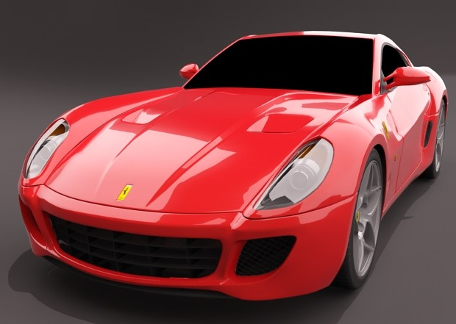
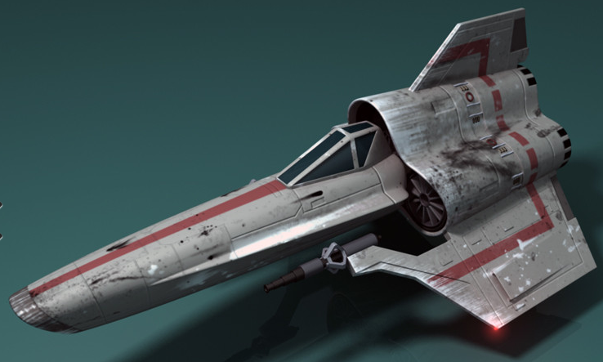
Graphs used for benchmarking
Connected components is commonly used as a sanity check, making sure there is only 1 components
Graphs from Matrix Market and Florida Sparse Matrix Collection can be used
3D models in computer graphics naturally have many components.
Graphs from free 3D models available in sites like turbosquid.com

Slide 6
Next steps
Finish algorithm implementation and validation
Run implementations on Xeon Phi
Benchmark algorithms with real world graphs
Plot graphs and write report

